Slide 1
Synapse Analytics Data Warehousing
By
Sunkari Manohar

Slide 2
Agenda
Project Statement
Project Overview
Project Requirements
Architecture
Project implementation
Conclusion

Slide 3
Project Statement
Set up a simple data warehousing project using Azure Synapse Analytics and integrate with azure sql pools and run the queries to visualize the data in charts.

Slide 4
Project Overview
In this project, we will establish a streamlined data warehousing system utilizing Azure Synapse Analytics. The foundation will include seamless integration with Azure SQL pools, ensuring a robust and scalable data infrastructure. By leveraging the power of Synapse Analytics, we aim to enhance data processing capabilities and optimize storage for efficient querying.
The project's core involves running targeted queries on integrated Azure SQL pools to extract valuable insights from the stored data. To visualize these insights comprehensively, we will employ charting tools, transforming raw data into meaningful graphical representations. This holistic approach not only underscores the efficiency of Azure Synapse Analytics in data management but also highlights the project's ultimate goal of delivering actionable insights through visually compelling charts.

Slide 5
Project Requirements
1. Azure Subscription
2. Azure storage accounts
3. Azure Synapse Analytics
4. Azure Synapse Studio
5. SQL pools
6. Visualization tools
7. SQL query tools
8. Documentation tools

Slide 6
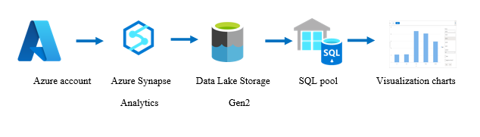
Architecture

Slide 7
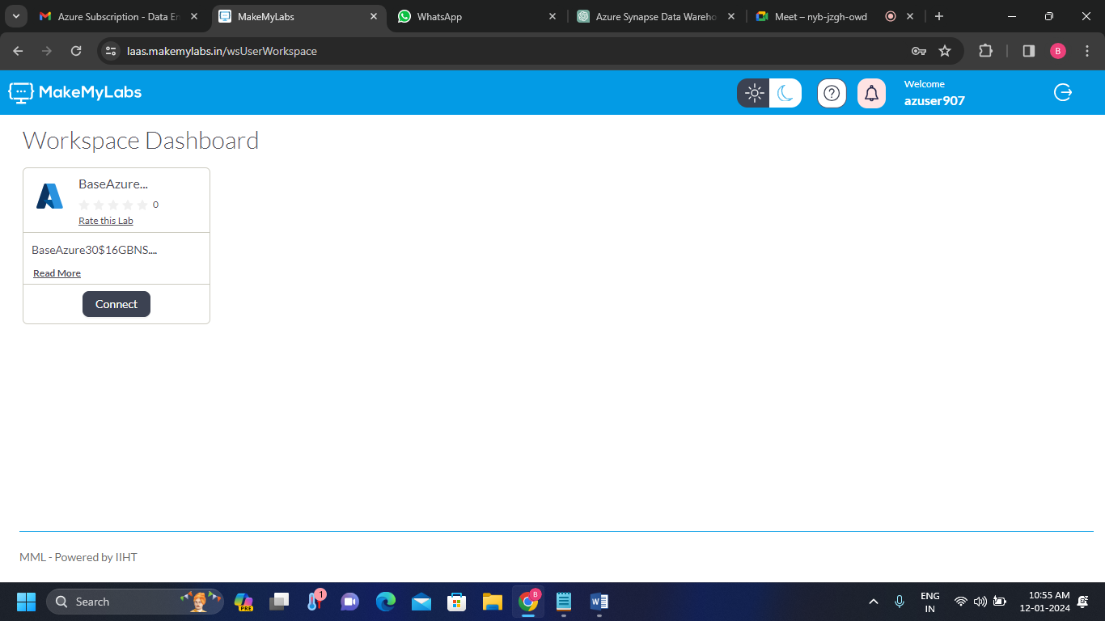
Project Implementation
1. Azure Subscription account
Login to the Azure Portal.

Slide 8
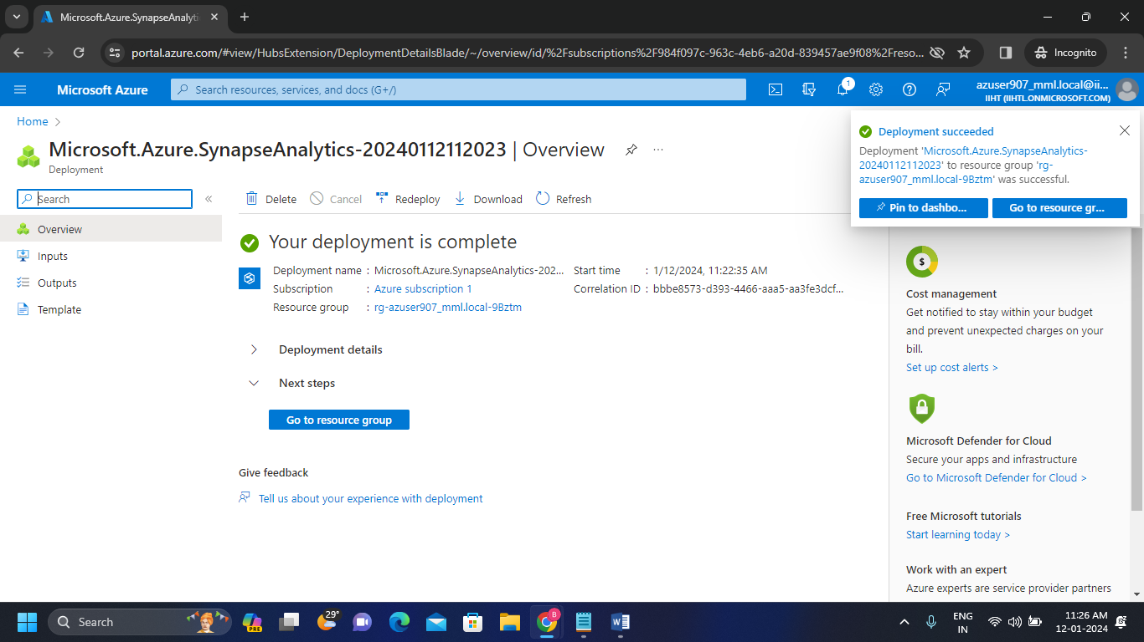
2. Azure Synapse Analytics
Create an Azure Synapse Workspace.

Slide 9
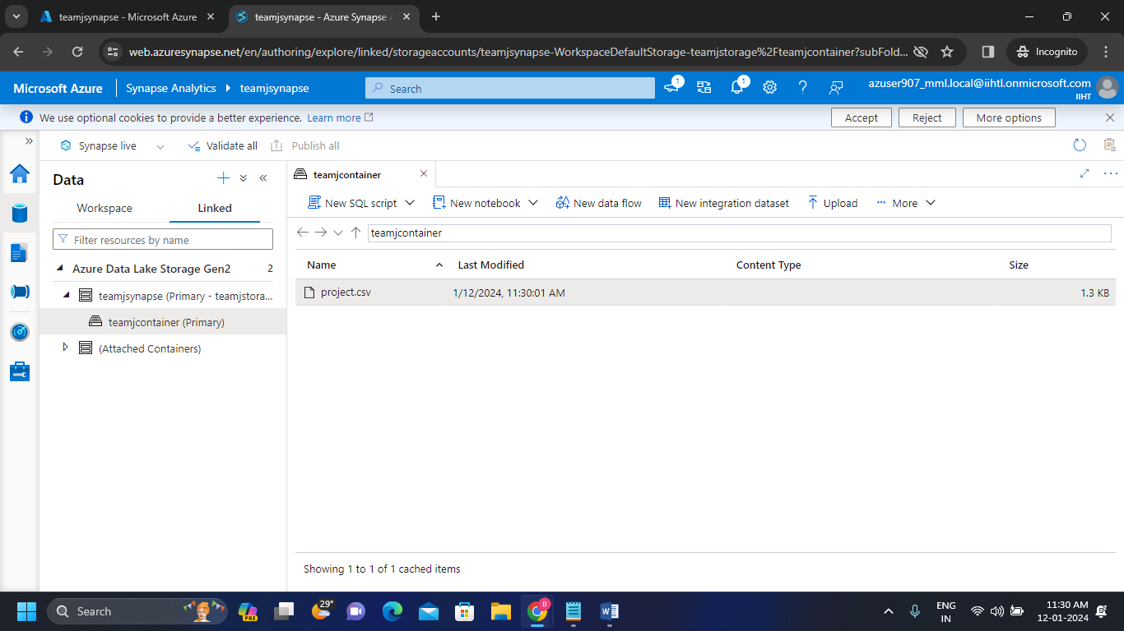
3. Uploading file inside the container
Upload the file inside the Data Lake Storage Gen2 container.

Slide 10
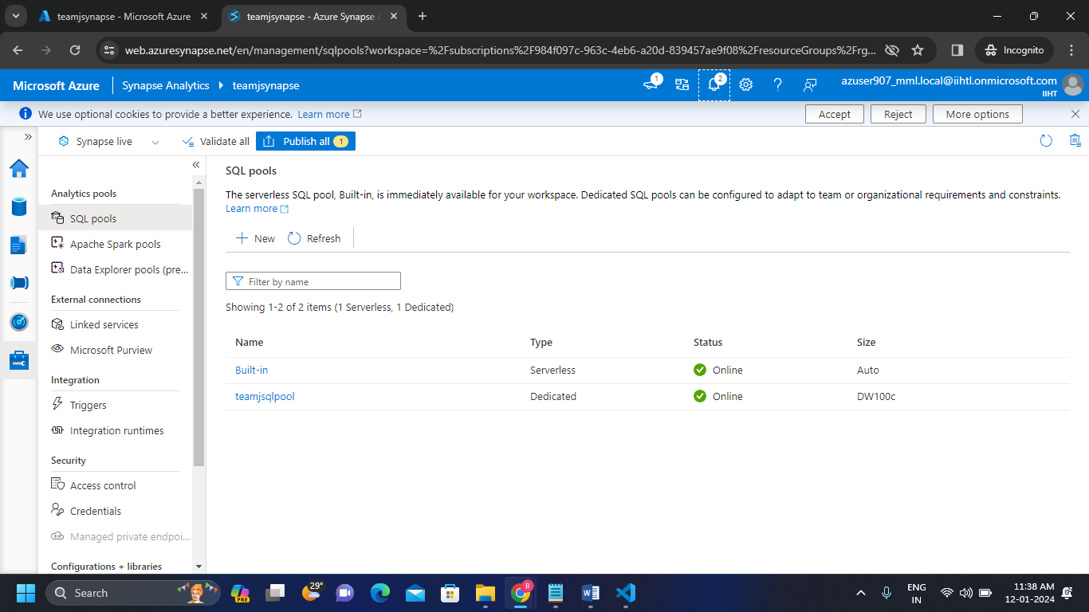
4. SQL pools creation
In the SQL pool there already exists a built-in serverless SQL pool. Create an dedicated SQL pool.

Slide 11
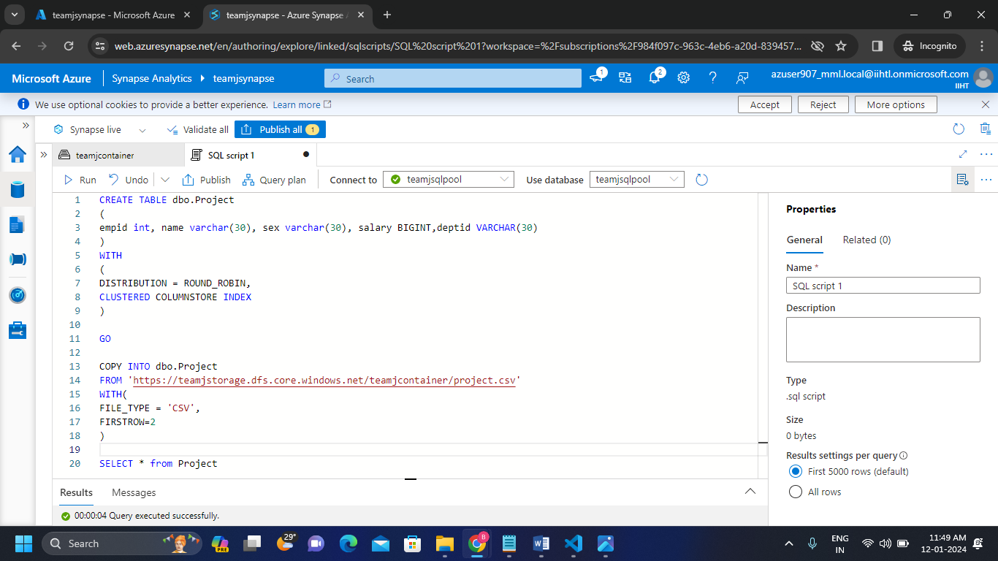
5. Table creation on Dedicated SQL pool
Create a table in the SQL script by copying the path of the file which is inside the container.

Slide 12
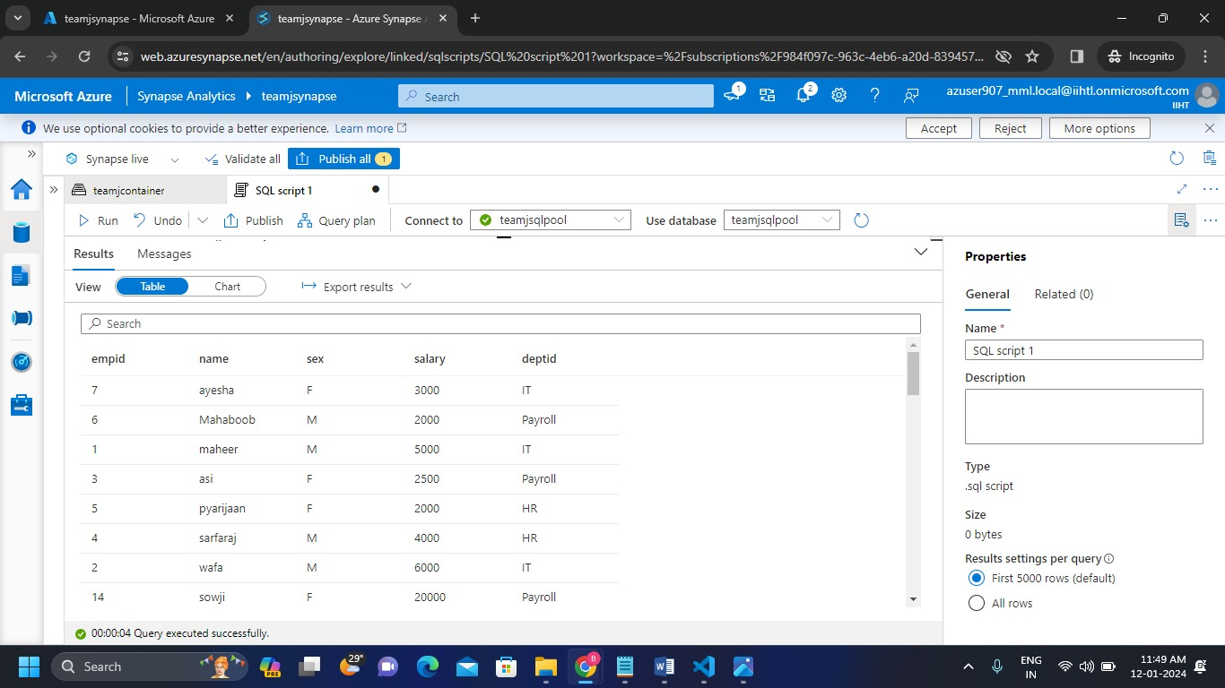
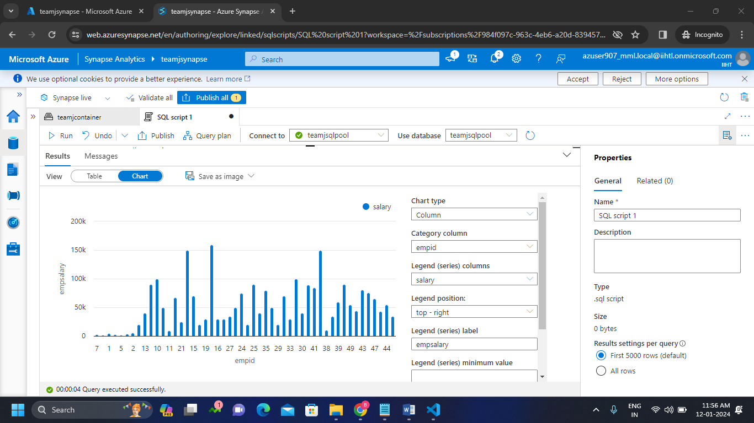
Output table and Visualization charts in Dedicated SQL pool
Run the Sql script and we can see the output table and also we can see the visualization charts of the output table.

Slide 13
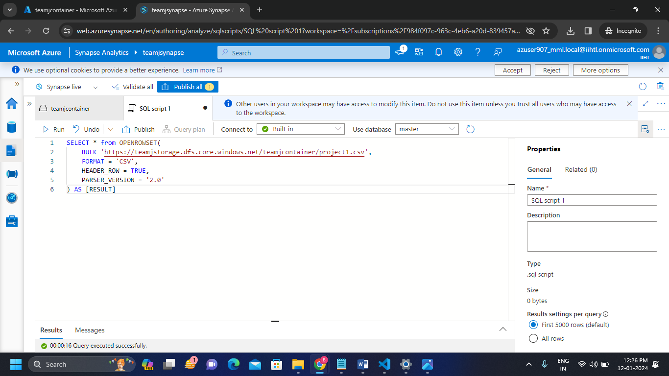
6. Table creation on Serverless SQL pool
Create a table in the SQL script by copying the path of the file which is inside the container.

Slide 14
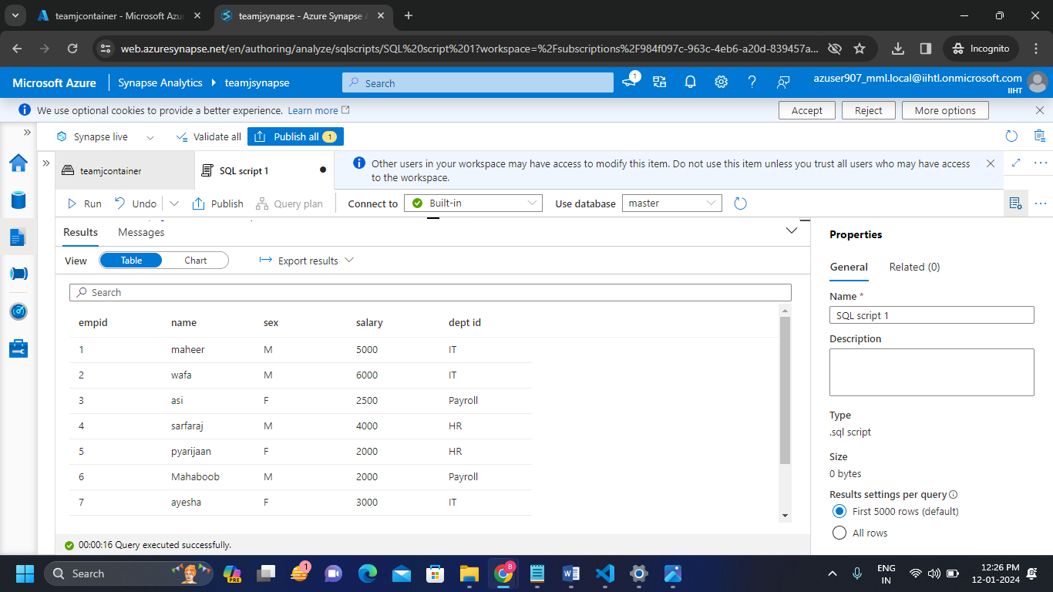
Output table in serverless SQL pool
Run the Sql script and we can see the output table

Slide 15
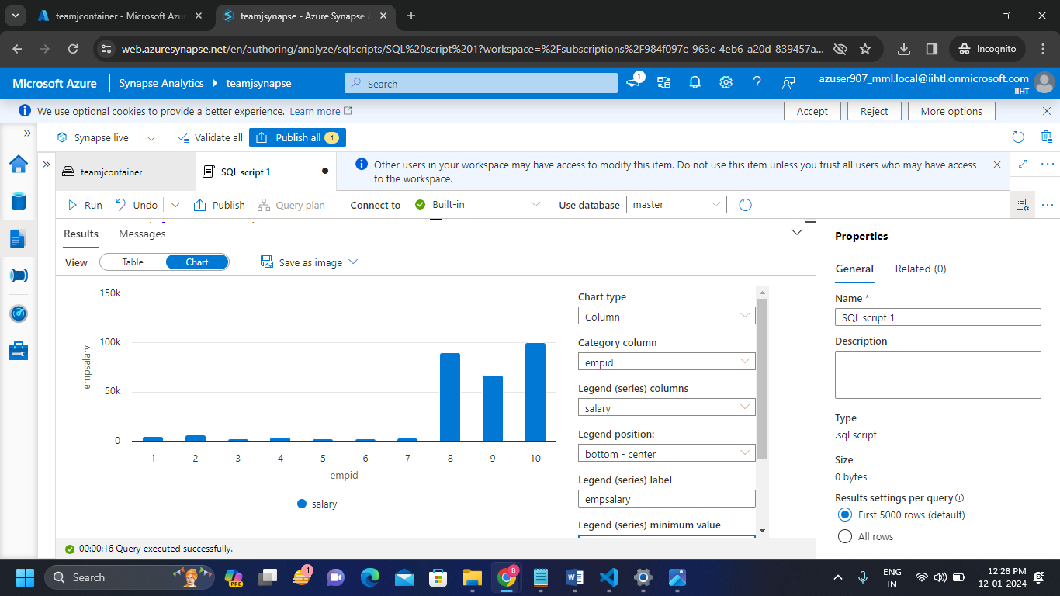
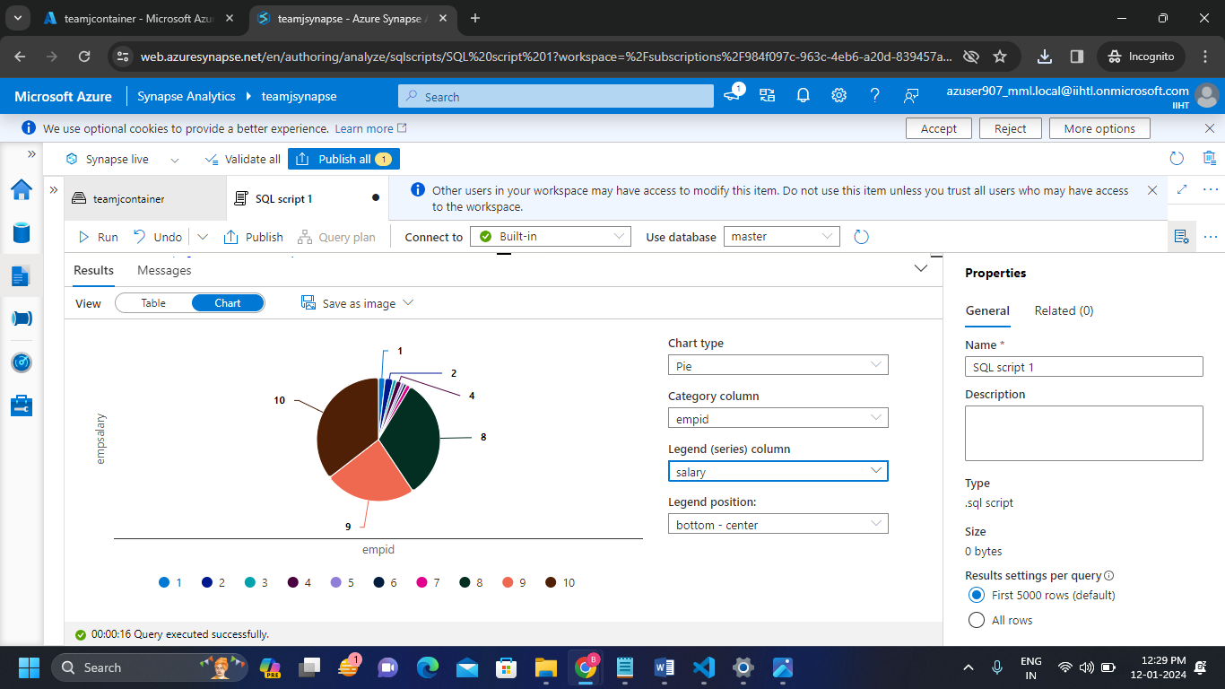
Visualization charts of serverless SQL pool
We can see the visualization charts for the output table.

Slide 16
Conclusion
Hence I successfully Set up a simple data warehousing project using Azure Synapse Analytics and integrate with azure sql pools and run the queries to visualize the data in charts

